Slide 1

An In-Depth Analysis into the Manufacturing Industry
Samsung electronics
VISHNU KRISHNAN, SANCHAL DHURVE, MARK THRASH

Slide 2
Datasets Analyzed
Samsung Stocks
Removed volume column from dataset as it was not relevant to generating a line chart displaying the trend of Samsung's adjusted closing share price over time.
Rounded Adjusted Closing Share Price column to 2 decimal places for more granularity in share price changes/fluctuations.
Top 120 Best-Selling Mobile Phones
Removed Smartphone (Yes/No) , Form Factor (Touchscreen, Bar, Flip phone etc.) and Year (Release Date) columns from dataset as they were not relevant to displaying total sales by manufacturer and drilling down to sales by specific model type.
Mobile Phone Prices
Removed Storage (GB), RAM (GB), Screen Size (In), Camera (MP), and Battery Capacity (mAh) columns from dataset as they were not relevant to displaying the most expensive phone models sold by specific manufacturers (i.e., Nokia).

Slide 3
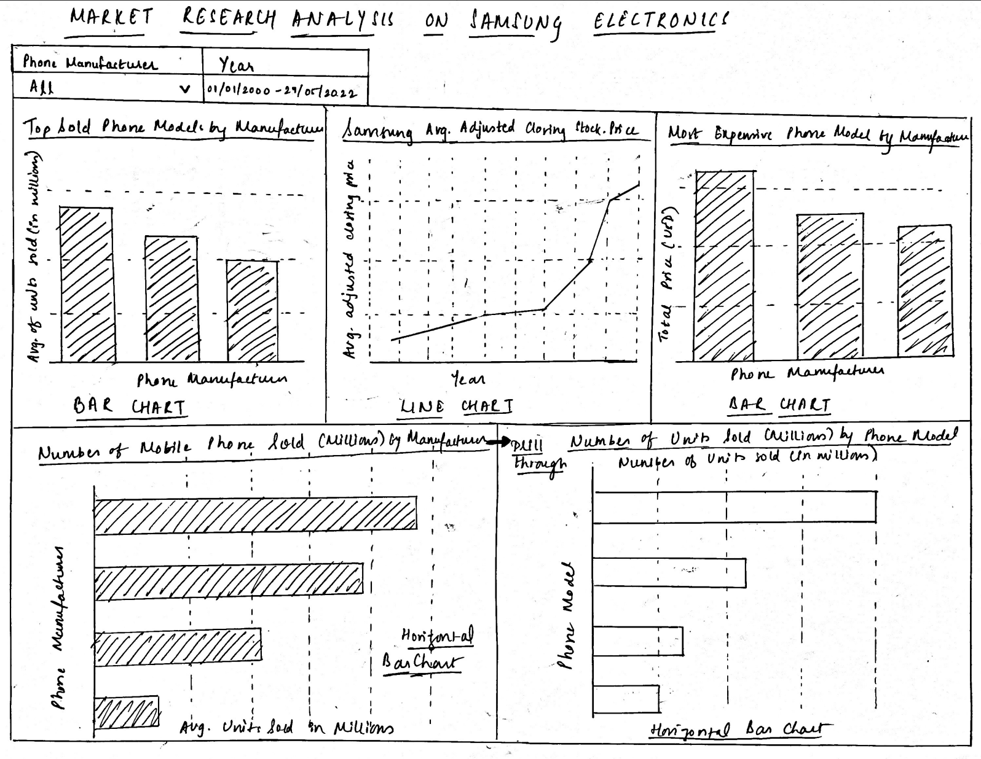
Dashboard Sketch
This dashboard sketch leverages three datasets: the Samsung Stock data set, Top 120 Best-Selling Mobile Phone's data set and the Mobile Phone Prices data set. The top-left bar chart highlights the top-selling phone models by manufacturer using sales data from the top 120 best-selling phones data set. The top-center line chart tracks Samsung's adjusted closing stock price (2000-2022), derived from the Samsung Stocks Data Set. The top-right bar chart showcases the most expensive phone models per manufacturer from the Mobile Phone Prices data set. The bottom-left horizontal bar chart aggregates total phone sales by manufacturer across all models, with a drill-through (bottom-right) detailing individual model sales. Filters for phone manufacturer and year enable interactive exploration.

Slide 4

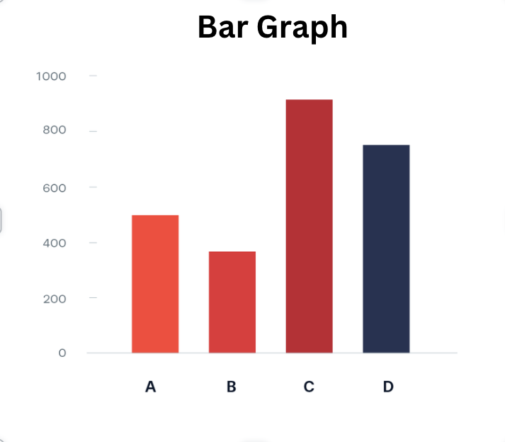
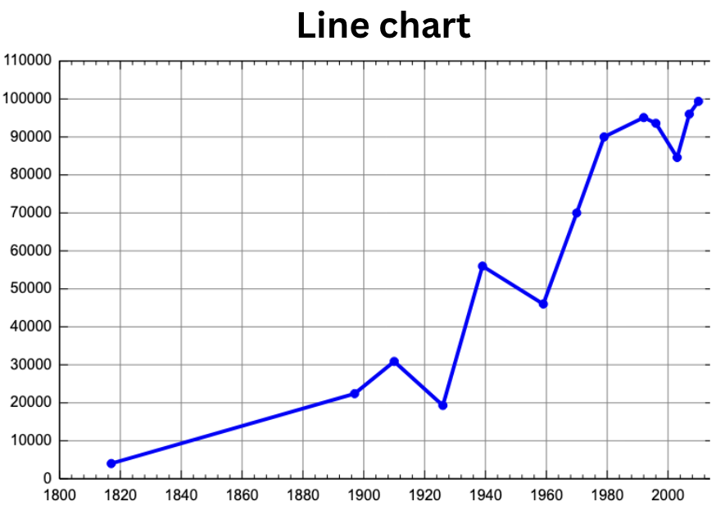
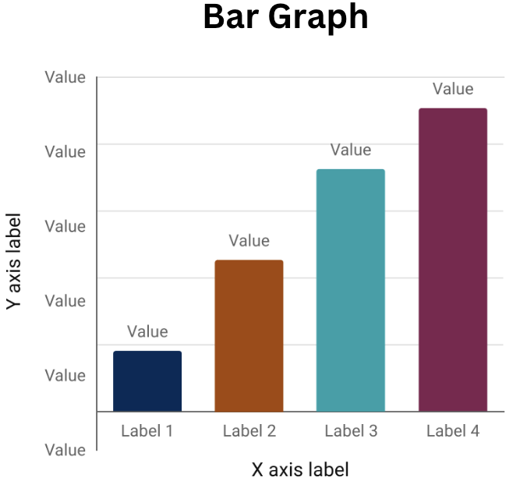
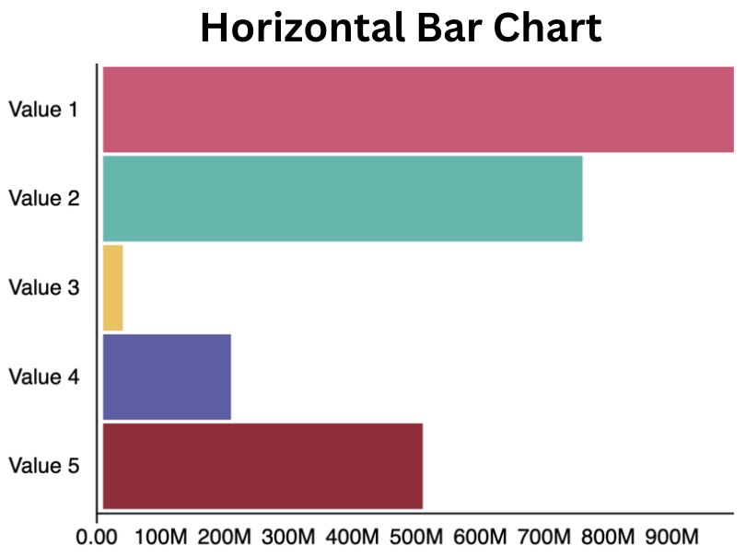
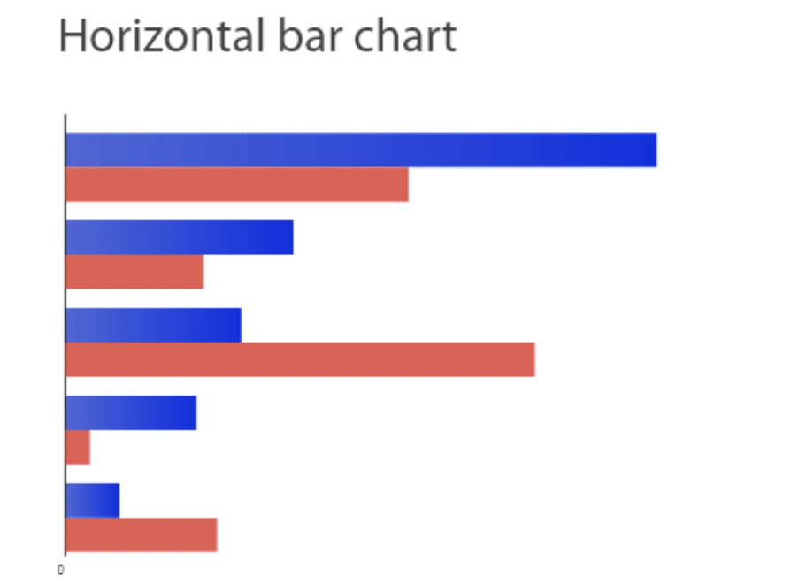

Storyboard
Drill-through

Slide 5
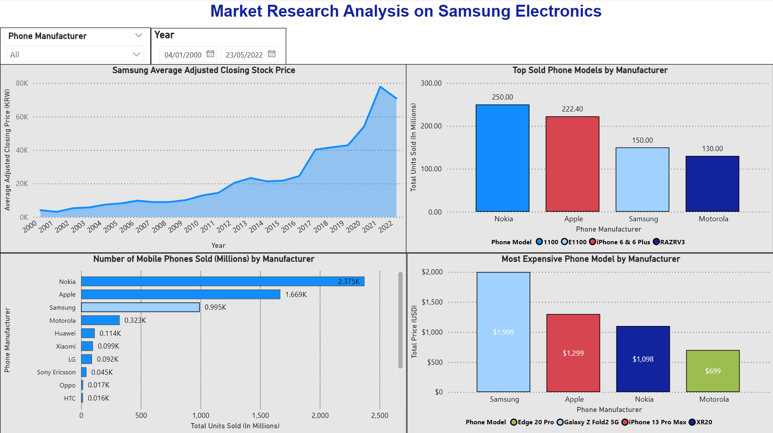
Final Dashboard

Slide 6

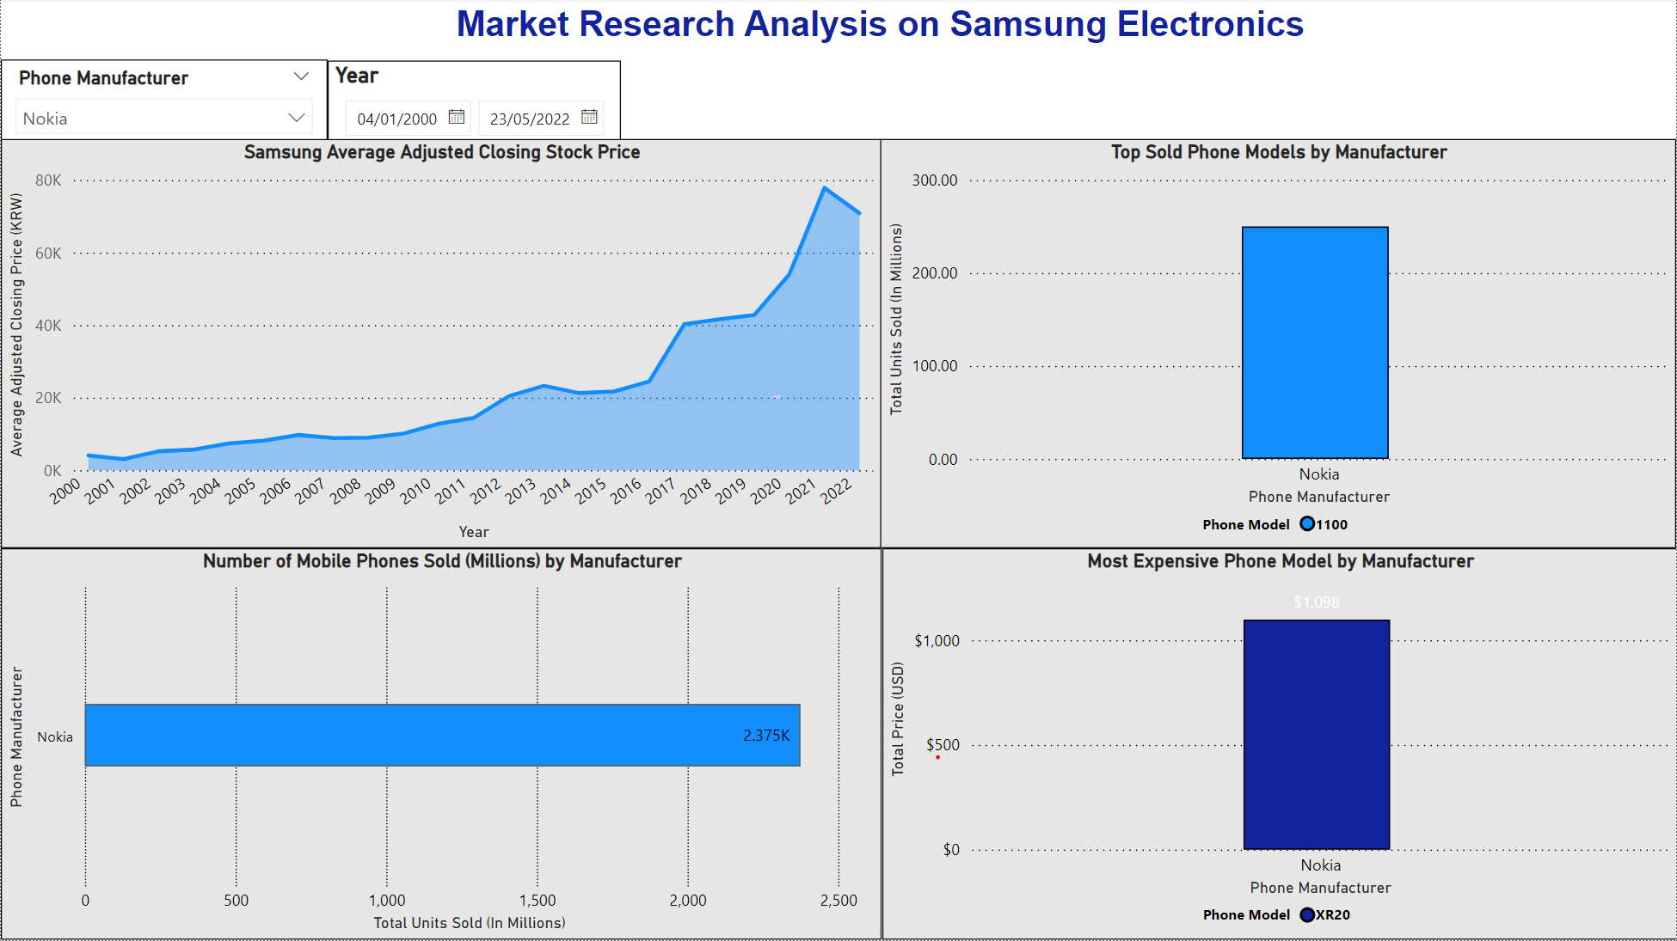
Dashboard Filters Example 1
Dashboard filtered by Phone Manufacturer, which further refines the outlined charts (in orange). The 'Top Sold Phone Models by Manufacturer' and 'Number of Mobile Phones Sold (Millions) by Manufacturer' charts use the same dataset, however the 'Most Expensive Phone Model by Manufacturer' chart uses a different dataset. In order to add a filter to further subdivide data on all of these charts by Phone Manufacturer, a relationship between the two dataset tables was required. In this example, Charts 2 – 4 (outlined in orange) were filtered based on the Phone Manufacturer Nokia.

Slide 7

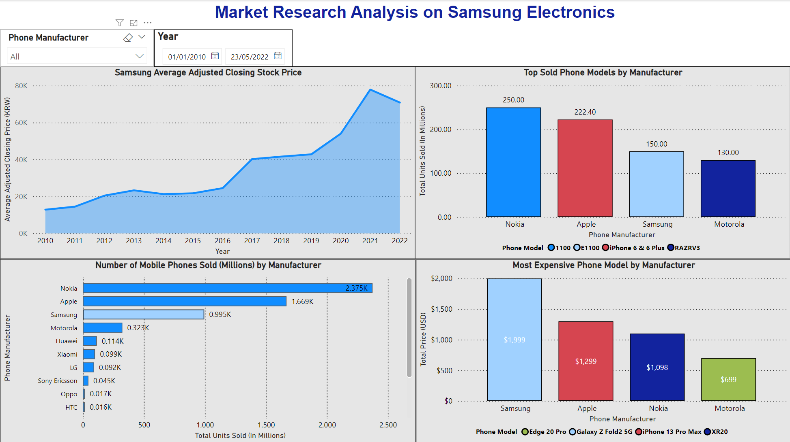
Dashboard Filters Example 2
Dashboard filtered by Year, which further refines the Samsung Average Adjusted Closing Stock Price chart (outlined in orange). This chart utilizes the Samsung Stocks dataset, which provides stock price data in KRW from 2000 – 2022. In this example, the trend in the share price is displayed based on the year filter applied, from 2010-2022.

Slide 8
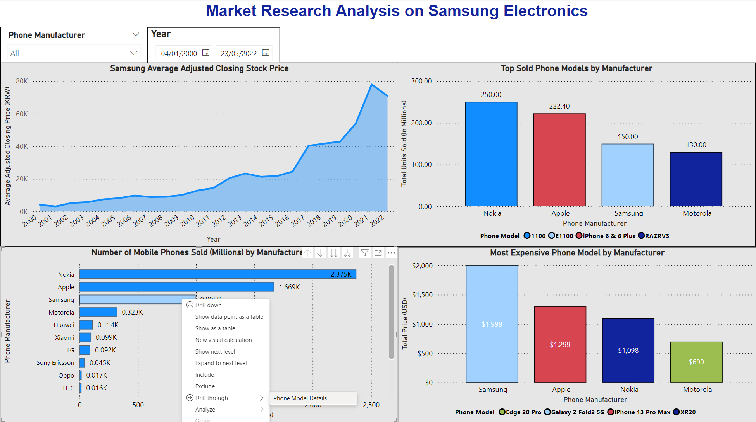
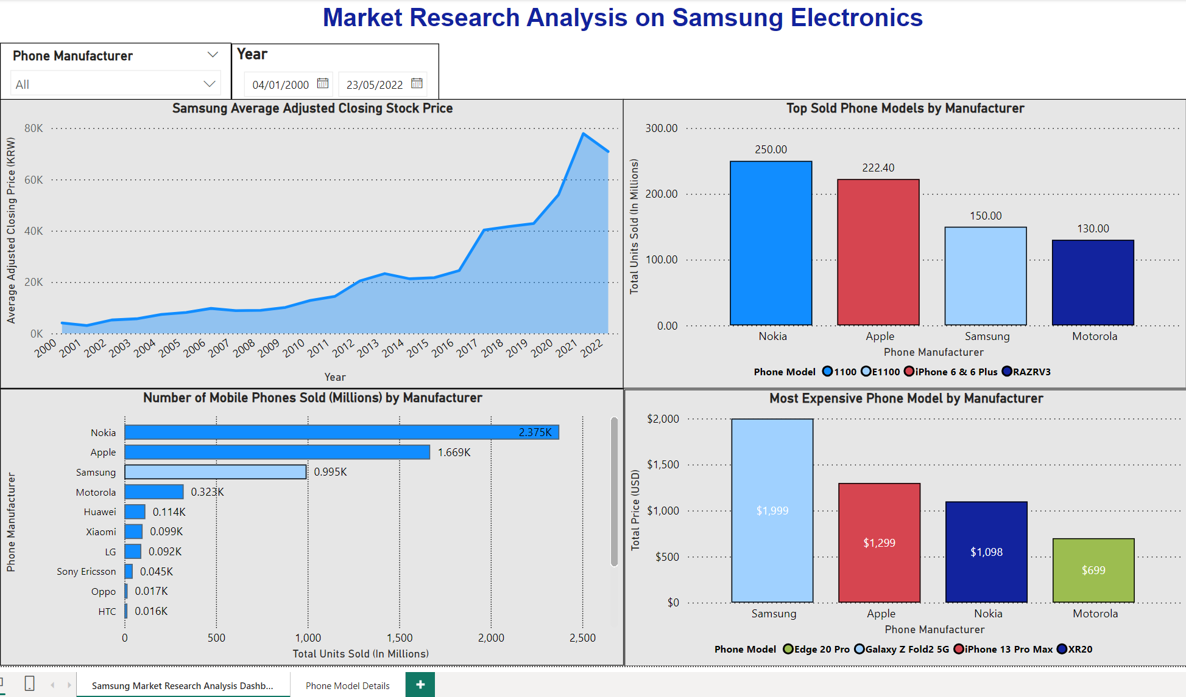
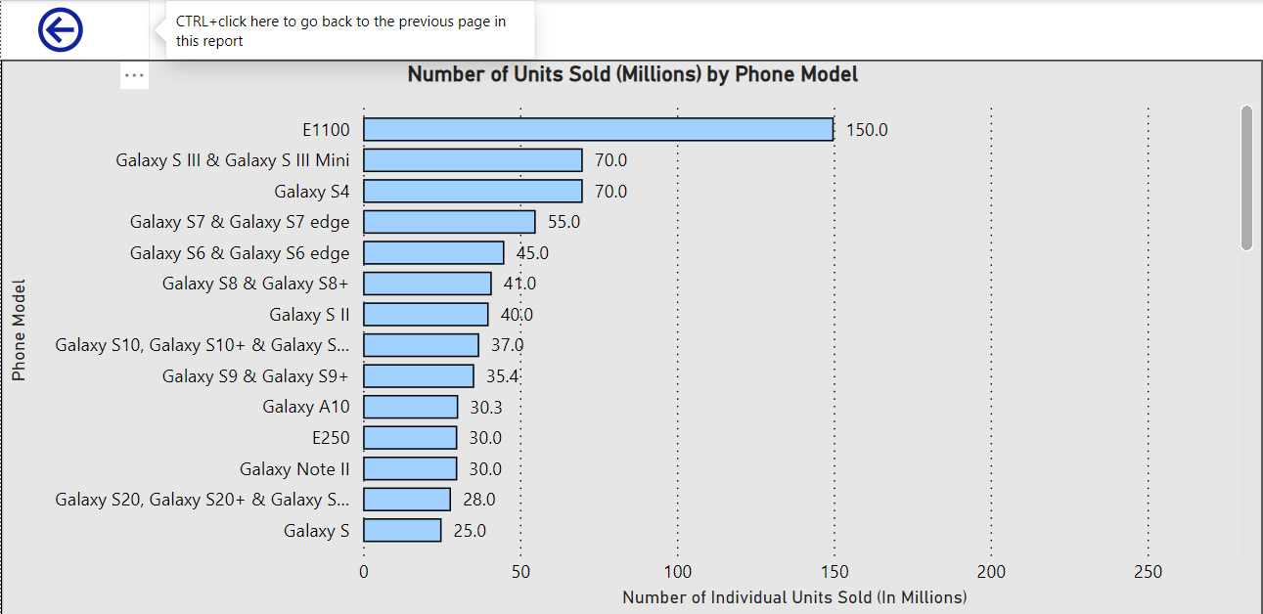
Dashboard Drill Through
Higher Level Dashboard Page
Detailed Page displaying Number of Units Sold by specific Samsung Phone Model
Drill Through on Samsung to Phone Model Details Page

Slide 9

The Story
Based on the analysis conducted through review of the dashboard generated ( on Slide 5), it is apparent there is a staggering increase in Samsung’s overall adjusted share price from 2000 – 2022, especially from 2016 onwards with an exponential rise in share price of 289.4% between 2016 and 2022. Based on the top 120 best-selling mobile phones data set as well as the dashboard chart, it is evident the Nokia is overall the highest sold mobile device brand, with approximately 1.4 times more devices sold than Apple and 2.4 times that of Samsung. Through analysis of the same data set, it was found that the highest sold phone model was the Nokia 1100 overall, followed by the Apple I Phone 6/6 plus, Samsung E1100 and subsequently the Motorola RAZRV3, accounting for the top 4 most popular models sold. Moreover, based on analysis of the Mobile Phone Prices data set and the corresponding dashboard chart, it was discernible that although Nokia outsold Apple and Samsung alike, Samsung phones on average were the most expensive out of the 4 reviewed, with the most expensive model being the Galaxy ZFold2 5G, which was almost $700 USD more than the Apple I Phone 13 Pro Max and approximately 2.8 times the price of a Motorola Edge 20 Pro.
After reviewing Samsung’s share price trend over the last 2 decades, it is obvious that the Manufacturing titan is growing and performing exceedingly well relative to its competitors in the industry. Although there is slight dip in the share price between 2021 to 2022, most likely attributed to the Global Pandemic at the time, it is important to note the exponential growth in the brand over the past 8-10 years alone. If someone is looking to potentially invest in the Manufacturing industry, and more specifically, consumer electronics, Samsung would be an ideal, safe, and astute choice. Consequently, if someone is in the market for a new mobile device with a strict budget, a Samsung device may not be the best choice as they are on average more expensive that their Apple or Nokia counterparts. From the dashboard. as well through the drill through feature available, and individual can quickly identify the most popular and highest sold mobile device model by a specific manufacturer in order to make the best-informed decision when deciding to purchase a new phone. Typically, most people tend to rely on sales metrics and/or consumer reviews when choosing between mobile devices, and thusly being able to see a more granular view of sales for specific models can facilitate such a decision much quicker. Even though Nokia is overall the most sold mobile device brand, most younger individuals and professionals, specifically Millennials and Gen Z’s, would prefer to purchase newer/more advanced next generation smartphones designed by Apple or Samsung. To reiterate, having such granular visibility to model type but also how one model compares to others within the same brand in terms of sales and subsequently the relative price variance between the different device brands simplifies an end user’s decision-making process without requiring extensive independent research across disparate sources.

